Slide 1

Biodiversity Analysis for the National Parks
Biodiversity Project of Codecademy
Yezehao Huai
yhuai001@fiu.edu

Slide 2
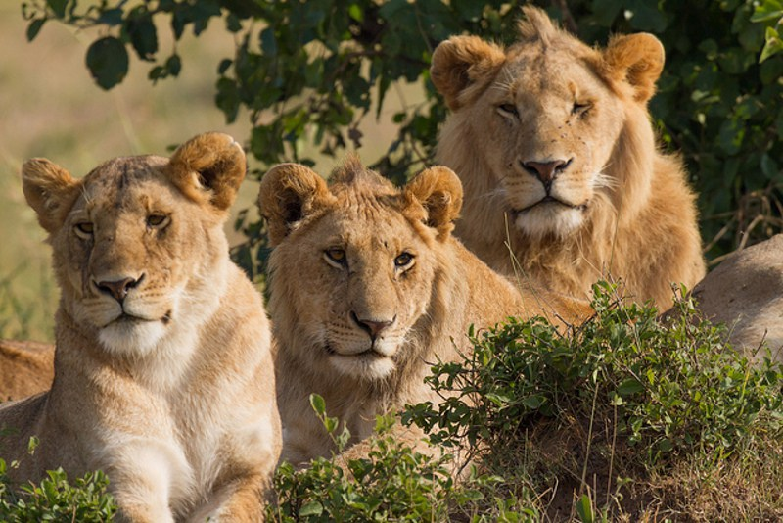
National Parks Service
点击添加文本
This a biodiversity analysis from the National Parks Service.
We focus on analyzing data about species at various national parks.
点击添加文本
点击添加文本
点击添加文本

Slide 3
Contents
1
Biodiversity
Analysis
Conservation Status
点击添加文本
2
Significance Test
点击添加文本
3
点击添加文本
Observations Plan
点击添加文本

Slide 4
Conservation Status
Key Indicators
Conservation Status
点击添加文本
Number of species
点击添加文本
The initial data include the scientific name, common names, and conservation status of each species. There are 5541 different species, 7 categories, and 4 conservation status.
We add “No Intervention” conservation status, and then get the number of species for each status by counting unique scientific name.
Conservation status | Number of species
In Recovery | 4
Threatened | 10
Endangered | 15
Species of Concern | 151
No Intervention | 5363
点击添加文本
点击添加文本

Slide 5
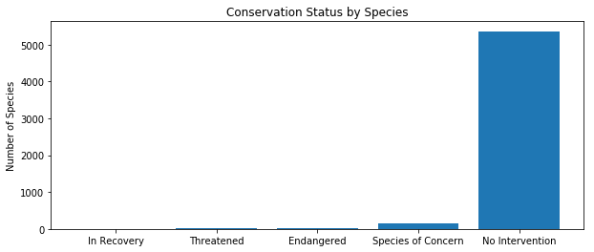
Conservation Status
点击添加文本
点击添加文本
点击添加文本
Species of Concern: Declining or appear to be in need of conservation
Threatened: Vulnerable to endangerment in the near future
Endangered: Seriously at risk of extinction
In Recovery: Formerly Endangered, but currently neither in danger of extinction throughout all or a significant portion of its range
No Intervention: Have no relevant evaluation
点击添加文本

Slide 6
Significance Test
We already know that most of the species in the National Parks have no intervention. Now we are going to test the significant difference between the species from different categories.
First of all, we define the protected state based on the conservation status and calculate the protected percent for each category.
点击添加文本
点击添加文本
Category | Not protected | Protected | Percent of protected
Amphibian | 72 | 7 | 0.088608
Bird | 413 | 75 | 0.153689
Fish | 115 | 11 | 0.087302
Mammal | 146 | 30 | 0.170455
Nonvascular Plant | 328 | 5 | 0.015015
Reptile | 73 | 5 | 0.064103
Vascular Plant | 4216 | 46 | 0.010793
点击添加文本
点击添加文本

Slide 7
Significance Test
Then, we create contingency table prepared for Chi Square Significant Test
点击添加文本
Category | Protected | Not protected
Category1 | num1 | num2
Category2 | num3 | num4
点击添加文本
If we get P value less than 0.05, it is significant. For example, the P value of test of the difference between Reptile and Mammal significant is 0.0383556 < 0.05, so it looks like there is a significant difference between Reptile and Mammal!
点击添加文本
点击添加文本

Slide 8
Observations Plan
Background
点击添加文本
Condition
Goal
点击添加文本
Conservationists have been recording sightings of different species at several national parks for the past 7 days. Some scientists are studying the number of sheep sightings at different national parks. There are several different scientific names for different types of sheep.
Scientists know that 15% of sheep at Bryce National Park have foot and mouth disease. Park rangers at Yellowstone National Park have been running a program to reduce the rate of foot and mouth disease.
The scientists want to test whether or not this program is working. They want to be able to detect reductions of at least 5 percentage point. We also want to know how many weeks would you need to observe sheep.
点击添加文本
点击添加文本

Slide 9
Observations Plan
At first, we need to get all the “Sheep” occur in common names and belongs to Mammal category merge with observations data. After that, we can group observations of sheep per week by different parks.
点击添加文本
Scientific Name | Park Name | Observations | Category | Common Names | Conservation Status | Protected
Ovis canadensis | Yellowstone National Park | 219 | Mammal | Bighorn Sheep, Bighorn Sheep | Species of Concern | True
Ovis canadensis | Bryce National Park | 109 | Mammal | Bighorn Sheep, Bighorn Sheep | Species of Concern | True
Ovis canadensis | Yosemite National Park | 117 | Mammal | Bighorn Sheep, Bighorn Sheep | Species of Concern | True
Ovis canadensis | Great Smoky Mountains National Park | 48 | Mammal | Bighorn Sheep, Bighorn Sheep | Species of Concern | True
点击添加文本
点击添加文本
点击添加文本
…….

Slide 10
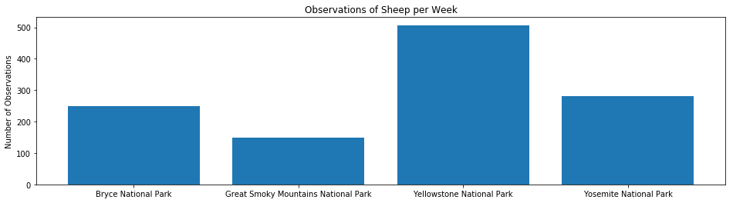
Observations Plan
Park Name | Observations
Bryce National Park | 250
Great Smoky Mountains National Park | 149
Yellowstone National Park | 507
Yosemite National Park | 282
点击添加文本
点击添加文本
点击添加文本
点击添加文本

Slide 11
Observations Plan Conclusion
点击添加文本
Finally, we calculate the sample based on baseline, minimum detectable effect, and level of significance, and we get sample size per variant is 510.
The result means we need 2 weeks to observe sheep at Bryce National Park and 1 week at Yellowstone National Park in order to observe enough sheep.
点击添加文本
点击添加文本
点击添加文本

Slide 12

点击添加文本
点击添加文本
点击添加文本
点击添加文本

